Slide 1
Introduction to Energy
Lesson Slides

Slide 2
The production and use of energy
Lesson 1

Slide 3
Energy flows
Energy Supply
Energy Transformation
Energy Demand
Finite resources
(e.g. coal, natural gas)
Renewable resources
(e.g. wind, sun)
Power stations
Extraction and refining
Electricity
(e.g. lights, appliances)
Heat
(e.g. heating homes, industrial processes)
Transport
(e.g. cars, boats, planes)
Identify which boxes the following activities sit: Production of natural gas; Burning gas for cooking; Gas occurring in undersea rock formations

Slide 4
Energy flows
Energy Supply
Energy Transformation
Energy Demand
Finite resources
(e.g. coal, natural gas)
Renewable resources
(e.g. wind, sun)
Power stations
Extraction and refining
Gas in undersea rock formations
Production of natural gas
Electricity
Heat
Burning gas for cooking
Transport

Slide 5
Energy flows
Energy Supply
Energy Transformation
Energy Demand
Finite resources
(e.g. coal, natural gas)
Renewable resources
(e.g. wind, sun)
Power stations
Extraction and refining
Gas in undersea rock formations
Production of natural gas
Electricity
Boiling water in kettle
Oil reserves
Production of jet fuel
Heat
Burning gas for cooking
Wind
Offshore wind farm
Transport
Passenger flight

Slide 6
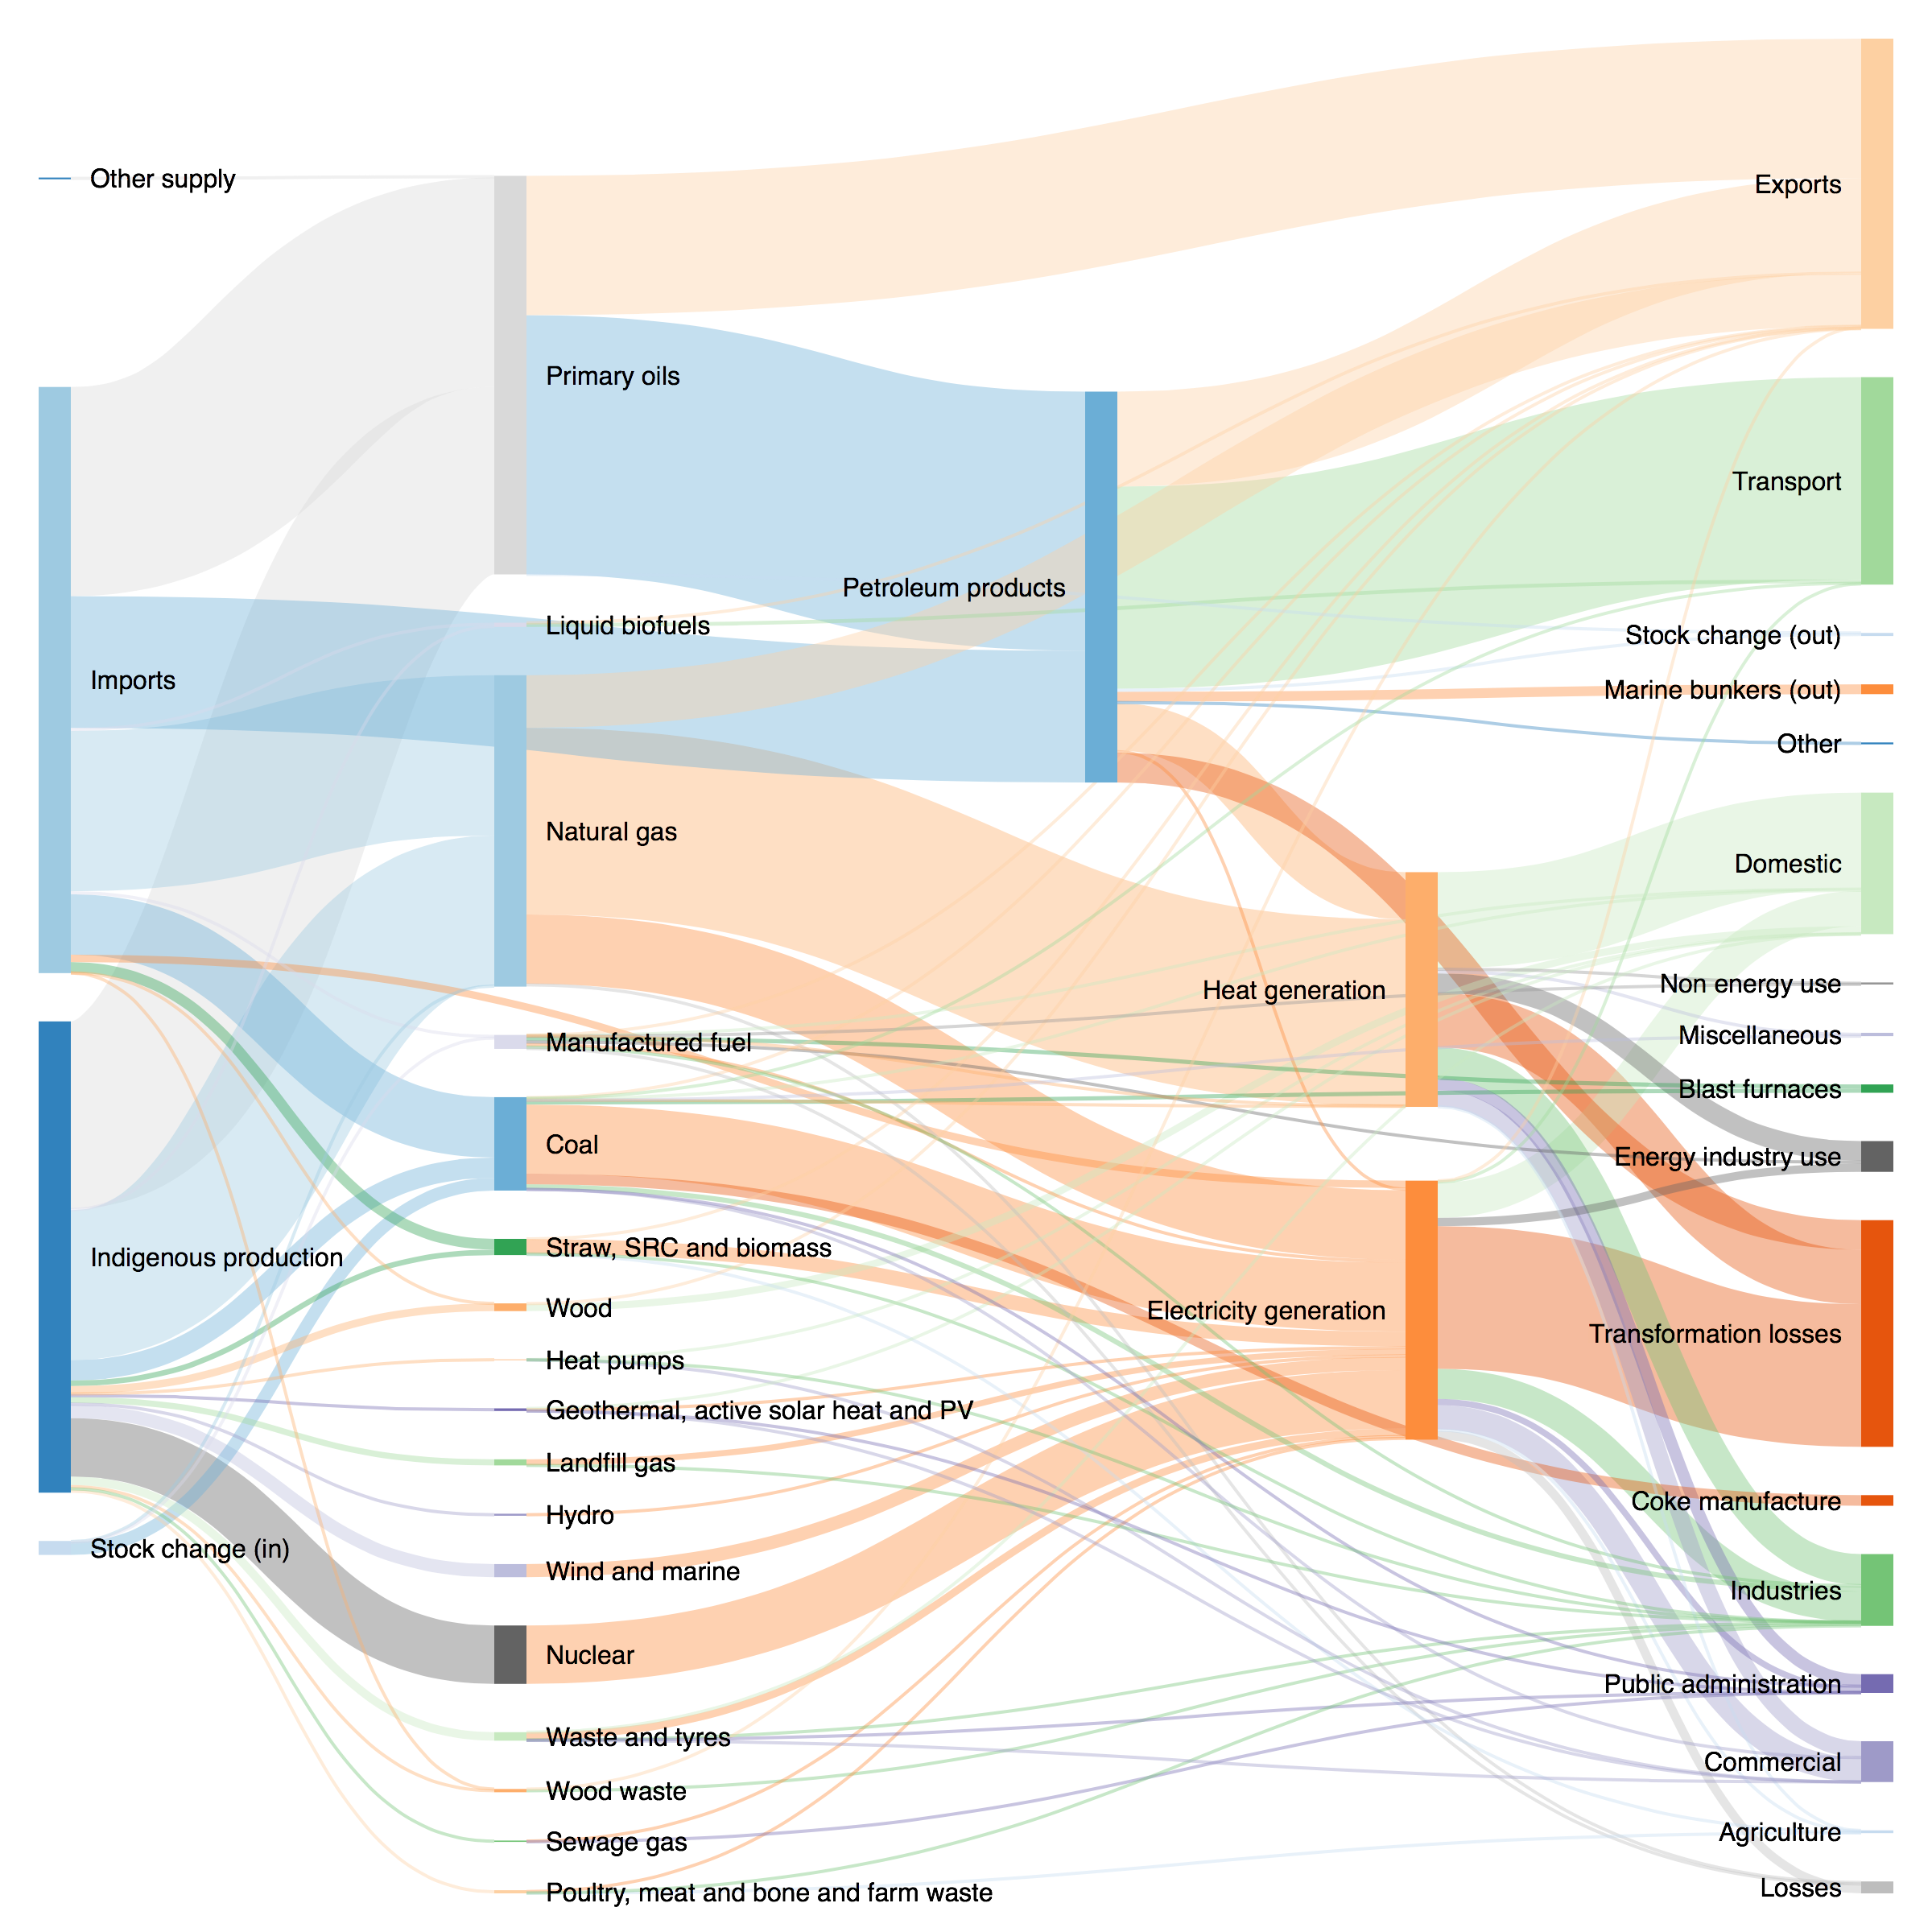
UK energy flows
Energy Supply
Transformation
Energy Demand
Energy Supply
Oil, natural gas, nuclear, coal and renewable sources (e.g. wind) are the main inputs to the energy mix;
There resources are produced within the UK (indigenous) and imported from around the world;
Energy Demand
Energy is used in:
the production of heat (e.g. gas for heating homes),
transport (petrol or diesel in cars); and
the generation of electricity in power stations;
Electricity and heat use can be split into domestic (e.g. people’s homes), industrial (e.g. factories) and commercial (e.g. supermarkets)
Energy is lost in the transformation of energy from one type to another and the transmission of energy from one place to another;
Some energy produced in the UK is exported – e.g. natural gas transported to Continental Europe and electricity to the island of Ireland through interconnectors;
Source: Digest of UK Energy Statistics (2016), Climate Cloud

Slide 7
Types of electricity generation
Input
Conversion
Output
Gas
Combustion to create steam in a boiler
Steam turbine
1
Coal
Biomass
Thermal
2
Nuclear
Radioactive heat
Steam turbine
Generator – converts kinetic energy to electrical energy
Electricity
Oil
Combustion in a reciprocating engine (like a car engine)
3
Biogas
Wind
Conversion of kinetic energy of a fluid (air / water) by a turbine (e.g. wind turbine / hydro turbine)
4
Hydro
Wave / tidal
5
Solar
Conversion of light energy to electrical energy in solar panels

Slide 8
Finite vs. renewable energy
Finite energy sources
Non-finite energy sources
Production
Energy is used faster than it can be produced naturally
Energy is used at the same rate it is produced
Energy types
Natural gas, coal, oil
Wind, solar, geothermal, tidal, nuclear
Example
Coal is produced over millions of years through organic material accumulating in shallow lakes and seas. Over time, heat and pressure is applied, transforming this organic material into coal.
Coal can be mined and combusted for energy generation earth much faster than it is replenished through these natural processes. This means that, over time, the resource will be depleted.
Wind energy uses turbines that transform the kinetic energy of the wind into electrical energy. Much like the wings of a plane, wind turbine blades use passing wind to generate motion that turns the blades, which creates electricity in a generator.
Electricity is generated at the same time the wind kinetic energy resource is available, and does not therefore run out.

Slide 9
UK electricity supply (2016)
Source: Digest of UK Energy Statistics (2017)
Available at: https://www.gov.uk/government/statistics/digest-of-uk-energy-statistics-dukes-2017-main-report

Slide 10
The UK electricity mix has changed significantly
What has changed?
Increase in renewables, promoted by government schemes to support renewable electricity and advances in technology;
Decreases in coal as plants reach the end of their lives and government policies making coal generation more expensive;
Increase in generation from gas;
Percentage of generation (%)
What drivers may have contributed to the changes shown in the chart?
Year

Slide 11
Energy Diary
Time | Activity | Type of energy use | Source of energy
07:00 | Breakfast | Electrical energy (microwave, kettle) | Electricity on the grid
07:45 / 16:00 | Travel to and from school | Chemical energy (petrol) | Petrol produced from oil
09:00 – 15:30 | School | Electrical energy for lights Heat energy to heat classrooms Electrical energy for computers | Electricity on the grid Gas from grid
12:30 | Lunch | Energy to produce foods: Energy to produce food – fertiliser, feed for animals etc.; Energy to transport food from source to plate; Heat energy to cook food; | Petrol produced from oil for Transport Gas for heating food
19:00 | Watch TV | Electrical energy for TV | Electricity from the grid
19:30 | Dinner | Electrical energy to produce heat for cooking | Electricity from grid
What is your energy diary for yesterday? Think through where you have used energy by consuming electricity, in heating and transport. Given the UK energy mix, where is this likely to have come from?

Slide 12
Reducing energy demand
How can you reduce your energy consumption? What are the costs and benefits associated with each?
Use less by changing what you do
Use less by using energy more efficiently
Electricity
Switch off appliances on standby;
Charging phones only for time required;
Switch off lights you don’t need;
Replace lights with LED bulbs;
Upgrade old appliances (fridge, washing machine)
Heat
Turn heating down by 1 degree;
Turn heating off in rooms that aren’t used;
Switch from oil to gas;
Home insulation;
Upgrade old gas boilers;
Transport
Cycle
Mass transit – bus / train / tram
Electric vehicles
Efficient driving;
Upgrade car to a smaller car / smaller engine;

Slide 13
Types of Renewable Energy
Lesson 2

Slide 14
UK Electricity Generation Mix (2016)
Types of renewable technology
Source: Digest of UK Energy Statistics (2017)
Available at: https://www.gov.uk/government/statistics/digest-of-uk-energy-statistics-dukes-2017-main-report

Slide 15
Renewable technologies
Wind
Solar
Hydro
Tidal
Geothermal
Biomass
Energy source
Kinetic energy of the wind
Heat and light energy from the sun
Kinetic energy of water in rivers
Kinetic energy of tides
Heat energy from the ground / air
Energy stored in organic material
Technologies
Wind turbines (onshore / offshore)
Solar PV
Solar thermal
Concentrated solar power
Run-of-river
Dams
Tidal lagoons
Underwater turbines
Deep geothermal
Air source heat
Ground source heat
Biomass combustion
Anaerobic digestion
Biofuels
Landfill gas
Energy use
Electricity
Electrticity / heat
Electricity
Electricity
Heat / Electricity
Heat, transport, electricity
What resources does the UK or your local geography have that might be used to generate renewable electricity?
Pick a renewable technology and describe what environmental conditions would best suit the technology. Consider the process of building and operating the applicable technology.

Slide 16
Types of electricity generation
Input
Conversion
Output
Gas
Combustion to create steam in a boiler
Steam turbine
1
Coal
Biomass
Thermal
2
Nuclear
Radioactive heat
Steam turbine
Generator – converts kinetic energy to electrical energy
Electricity
Oil
Combustion in a reciprocating engine (like a car engine)
3
Biogas
Wind
Conversion of kinetic energy of a fluid (air / water) by a turbine (e.g. wind turbine / hydro turbine)
4
Hydro
Wave / tidal
5
Solar
Conversion of light energy to electrical energy in solar panels

Slide 17
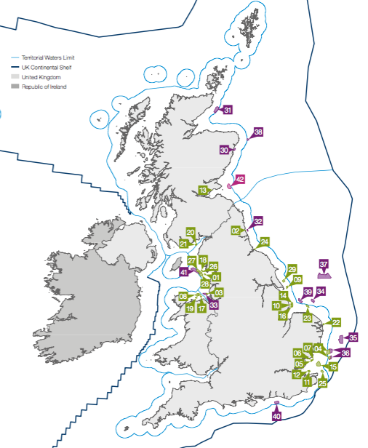
Case Study: UK Offshore Wind (1)
Offshore wind was responsible for c. 5% of the UK electricity generation mix in 2016;
Due to the UK’s shallow continental shelf and regular, predictable wind speeds, it is likely to be an increasingly important contributor to UK electricity;
Wind speeds are higher and more predictable offshore than onshore;
Less public opposition as offshore wind developments have less visual and noise impacts compared with onshore wind projects;
Higher costs to develop and operate offshore projects due to the complexities of installing turbines offshore.
UK is the world leader in offshore wind, with more capacity installed than any other country.
UK offshore wind projects in operations (green) or development (purple). Source: The Crown Estate

Slide 18
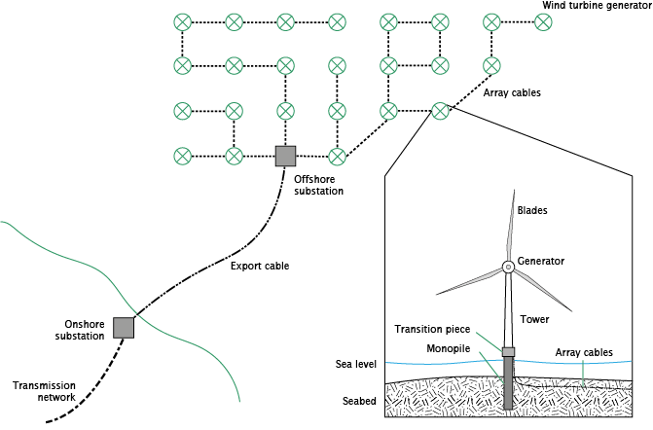
Case Study: UK Offshore Wind (2)
Key Components of an Offshore Wind Farm
Wind turbine generators (“WTGs”);
Foundations;
Array cables (network between WTGs);
Export cables (transmit electricity from offshore to onshore);
Substations
Research online to find an example of a UK based offshore wind farm.
Summarise the key characteristic of the project.

Slide 19
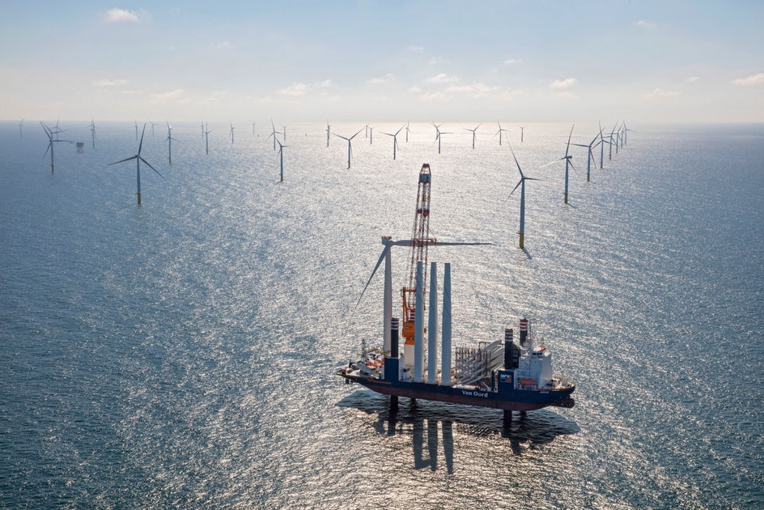
Case Study: UK Offshore Wind (3)
Gemini wind farm, Netherlands

Slide 20
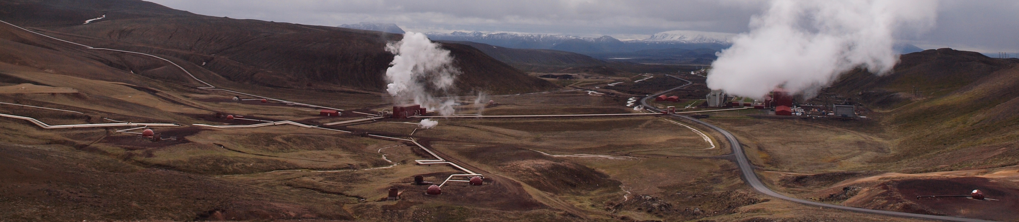
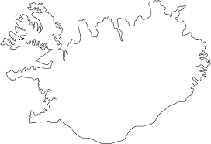
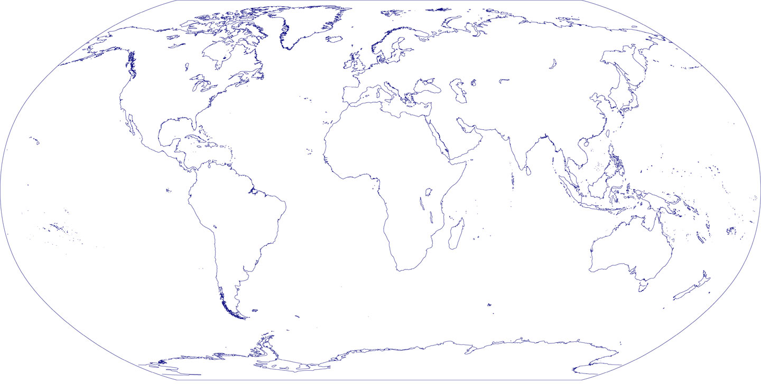
Case Study: Geothermal
Krafla Geothermal Plant, Iceland, Europe
The Krafla Geothermal Plant is located near Myvatn, Iceland. The power station commenced development in 1977, with regular operations starting the following year. The plant has 18 boreholes, through which water is pumped into the earth’s surface to a depth of up to 2.2 km. The water is heated by the naturally occurring hot rocks, where it is turned to steam and returns to the surface at pressure.
The steam is transported by overground pipes (see picture above) to two 30 MW steam turbines, where the heat and pressure is converted to electricity.
The project is located in a highly volcanic area of Iceland, at the location the Mid-Atlantic Ocean ridge meets land. At this location, the European and American tectonic plates are moving apart. The last period of volcanic activity was in 1977, as part of an eruption called the Krafla fires.
Iceland

Slide 21
Energy challenges
Lesson 3

Slide 22
The Energy ‘Trilema’
Green Agenda
Demands to reduce the production of greenhouse gases to avoid environmental impacts
Security of supply
Meeting energy demand to ensure there are no ‘black-outs’
Reliance on other states to supply energy through imports
Energy Policy needs to balance three elements
Cost of energy
Minimising the cost of energy for consumers and businesses

Slide 23
What drives energy cost (1)?
The cost of energy is a function of its generation and transport
Generation
Upfront costs
How much does it cost to build or discover the energy generation?
Ongoing costs
How much does it cost to operate and maintain the energy generation?
Cost of Energy
££££
Input costs
What inputs are required (e.g. fuels such as coal) and how much does this cost?
End of life costs
What happens when the resource can no longer generate?
Transport
Distance
How far away is the energy supply from the energy demand?
Losses
What energy is lost in transportation?

Slide 24
What drives energy cost (2)?
The below table shows different sources of energy and whether the cost of generating and transporting that energy is high / medium or low. Discuss and explain the factors resulting in the cost profile for each.
High cost
Generation
Transport
Reasons / Explanation
Medium cost
Upfront costs
Ongoing costs
Input costs
End of life costs
Distance
Losses
Low cost
Electricity (nuclear)
Electricity (gas)
Electricity (offshore wind)
Transport (petrol car)
Transport (electric car)
Heat (burning oil)

Slide 25
What drives energy cost (3)?
The below table shows different sources of energy and whether the cost of generating and transporting that energy is high / medium or low. Discuss and explain the factors resulting in the cost profile.
High cost
Generation
Transport
Reasons / Explanation
Medium cost
Upfront costs
Ongoing costs
Input costs
End of life costs
Distance
Losses
Low cost
Electricity (nuclear)
Large projects with high upfront and decommissioning costs. Plentiful fuel.
Established technology. Fuel costs based on gas price
Electricity (gas)
Electricity (offshore wind)
New technology and complex offshore build / end of life. Wind is free.
Established product, widely available. Petrol costs high.
Transport (petrol car)
Transport (electric car)
New product early in life. Relies on centrally generated power for recharge
Heat (burning oil)
Widely available efficient technology. High costs to buy and deliver oil

Slide 26
Security of supply
Ensuring energy supply meets demand: ‘Keeping the Lights on’
Global competition for resource
Population growth
Politics of energy
Energy Supply
Energy Demand
Economic growth
Fuel costs
Energy efficiency
Technology mix
Technological change
Available reserves / new discoveries
Weather
Discuss the links between politics and energy.
Think about:
Why do politicians care about ensuring supply meets demand? How critical is energy to society?
Are energy resources equally distributed around the globe?
What are the risks of political instability on the supply of energy?

Slide 27
Green agenda
Renewable technologies have advantages and disadvantages
Benefits
Challenges
Wind
Plentiful resources – UK has some of the best wind resources in the world, in particular offshore due to shallow waters and high wind speeds;
Intermittent supply that is hard to predict;
High capital costs (costs to build);
Visual impacts on the landscape;
Solar
Lower capital and operating costs compared with other renewables, with costs reducing significantly as more capacity is deployed;
Intermittent, but more predictible than wind;
Limited UK resource, with solar being more feasible in the South compared with the North of the country;
Hydro
Very predictible and can meet ‘baseload’ requirements (i.e. generates all the time);
Environmental issues of diverting or damming rivers – river biodiversity
Environmenta impacts of large new lakes
Tidal
Predictible (based on the timing of tides);
UK has good tidal resources;
High capital costs to install and ongoing costs to operate and maintain
Environmental issues with building tidal lagoons – fish and bird life
Geothermal
Predictible, baseload energy supply.
High cost to build in the UK, limited resources due to geology;
Limited heat networks to transport heat to end users
Biomass
Predictible, baseload supply;
Can use existing coal plants (co-firing / conversion), reducing the need for new infrastructure;
Sustainability issues – ensuring the biomass is produced in a sustainable way;
Energy crops – impacts on food availability / prices where agriculture shifts to energy production from food.

Slide 28
Energy policy examples
Green Agenda
Security of supply
Subsidies for renewable technologies to enable them to compete with conventional generation;
Additional taxes or costs on fossil fuelled generators (e.g. carbon emissions tax);
Changing building regulations for new homes, requiring more energy efficient homes;
Support for electric vehicles – e.g. building a charging network
Transport sharing / additional public transport
Promotion of national infrastructure to reduce reliance on foreign geographies;
Diversification of energy sources, to ensure there is no reliance on a single technology (e.g. nuclear);
Energy Policy needs to balance three elements
Cost of energy
Subsidise energy costs, in particular for those least able to pay;
Price caps / regulated pricing;
Promotion of smart meters, providing information relating to energy use and cost;
Can you think of any other policies governments may use to support any aspect of the trilema?

Slide 29
Energy policy exercise
The table below shows a number of energy policies. By re-creating this table, comment on each against the three aspects of the energy trilema.
Policy
Security of supply
Green agenda
Cost of energy
The introduction of subsidies for renewable energy
Development of new nuclear power stations
Implementation of a gas supply price cap for residential customers
Development of new electricity interconnectors with Europe

Slide 30
Energy policy exercise (2)
The table below shows a number of energy policies. By re-creating this table, comment on each against the three aspects of the energy trilema.
Policy
Security of supply
Green agenda
Cost of energy
The introduction of subsidies for renewable energy
Solar and wind are intermittent and therefore unpredictable.
Subsidies promote the deployment of renewable generation
Subsidies increase the cost of energy as the cost of the subsidy is passed to end users
Development of new nuclear power stations
Nuclear power is highly predictable and constant
Emissions from the operations of a nuclear plant are low
High cost of energy as a result of high upfront costs associated with construction
Implementation of a gas supply price cap for residential customers
Unlikely to have an impact on security of supply
Unlikely to have an impact on green agenda
Capping energy prices limits the costs consumers pay
Development of new electricity interconnectors with Europe
More interconnection increases the potential sources of supply and therefore enhances security
Dependent of the make-up of energy at the source
Interconnectors are expensive to build and the costs of the energy is dependent on the cost of energy at the origin

